Slide 1
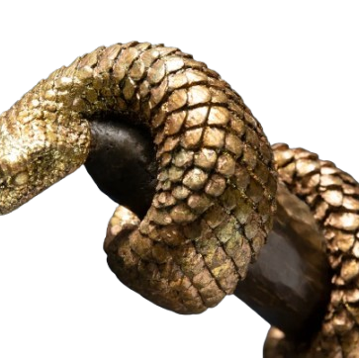
NEHUSHTAN ןָּתְשֻחְנ
Or, God’s good gifts that God’s people turn to evil

Slide 2
In the final year of the Quinquennium Theme

Slide 3
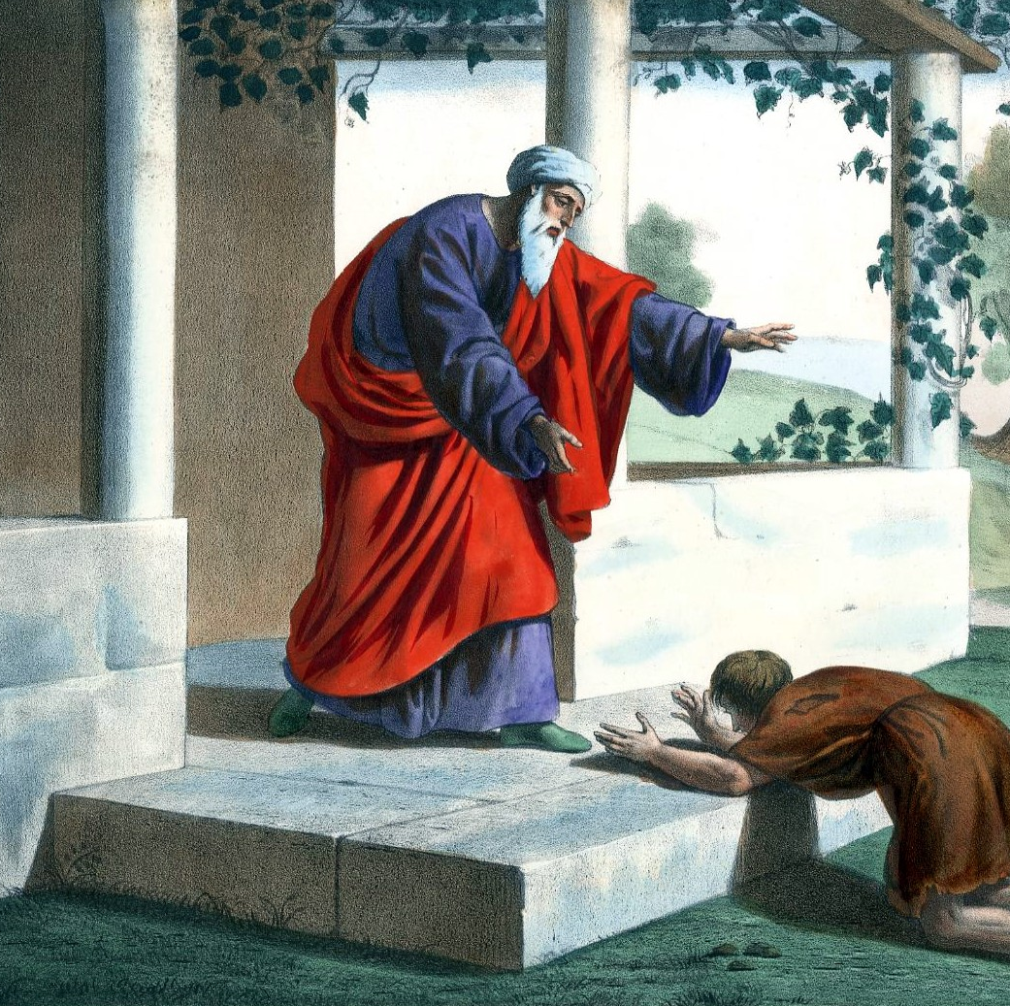
2025 Theme: A RETURN TO THE FATHER
I will arise and go to my father, and will say to him, “Father, I have sinned against heaven and before you – Luke 15:18

Slide 6
But the hour is coming, and is now here, when the true worshipers will worship the Father in spirit and truth, for the Father is seeking such people to worship him. God is spirit, and those who worship him must worship in spirit and truth.”
– John 4:23-24

Slide 7
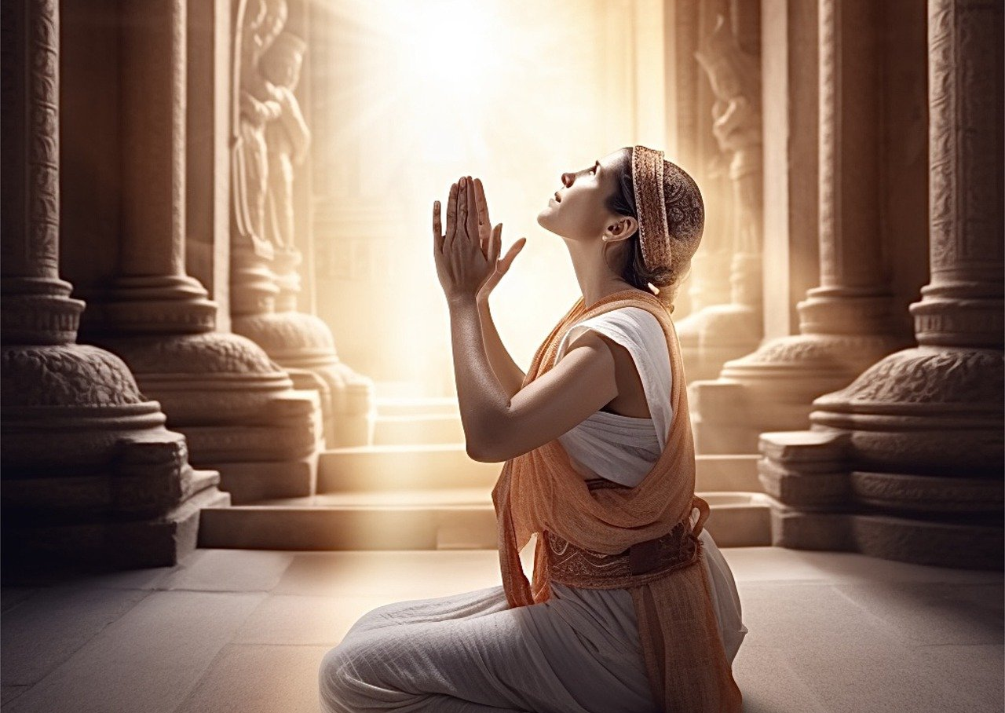
"Hear, O Israel: The LORD our God, the LORD is one. And you shall love the LORD your God with all your heart and with all your soul and with all your strength".
– Deuteronomy 6:4-5

Slide 8
01
HEART
From within in Truth, Reverence, and In Commitment
From Outside Actions, Character
Thought and Deep In Spirit
03
STRENGTH
02
SOUL

Slide 9
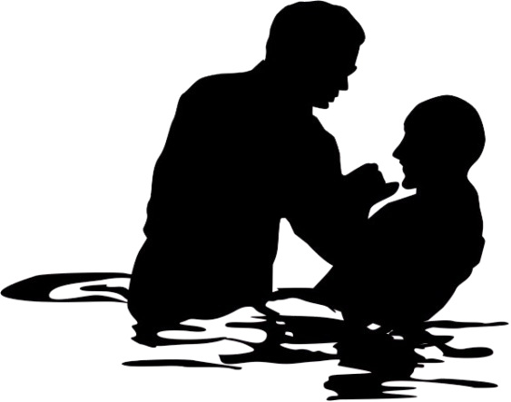
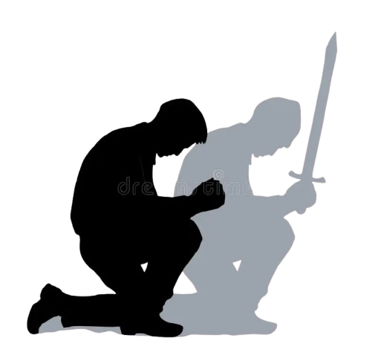
Important Components of Worship
PRAYER: Connecting to God; committing our dependency to Him by reaching out and calling
1
6
WITNESS/EVANGELISM: Teach and Reach our children, our community and the World about God’s Love
DEVOTION: Service to God and For God in our entirety. Our Strength/Talents committed to Him first.
2
GOD
5
HARK & SEE: Learn and Study God’s Will and Statutes through scripture with a contrite and open heart.
APPRECIATION/GRATITUDE giving thanks, offering, and honor back to God for who He is. And in Praise and in Song
3
4
COMMUNION/ACTION: Show by example God’s Love and Character

Slide 10
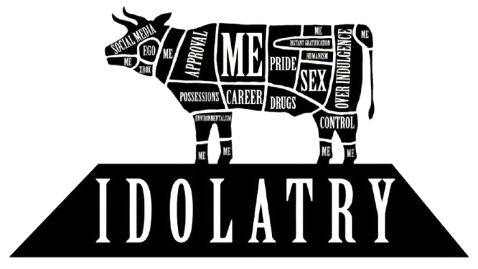
What are we worshipping today?

Slide 11
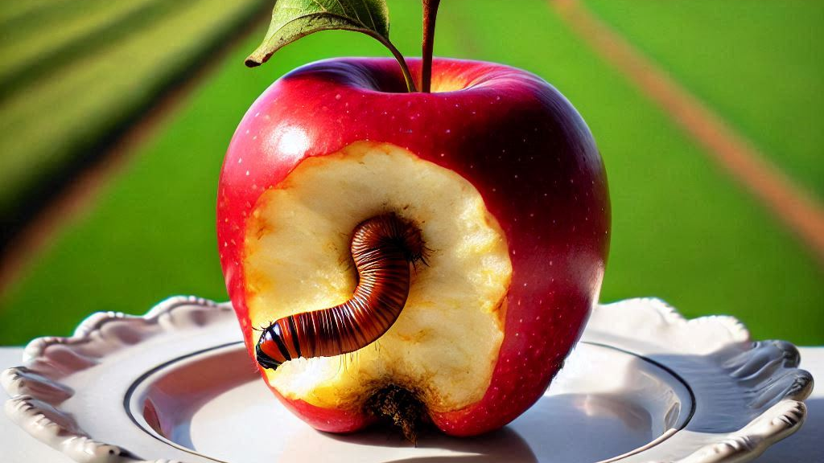
When God’s goodness is turned into evil by God’s people

Slide 12
Part 05 – HARK & SEE!
Opening Eyes Wide Shut
PRESENTATION OUTLINE
Part 03 – The Way We See It
Part 04 – A Name for Ourselves
What informs our thinking when we are in Worship?
A brief analysis of ancient practice;
Understanding our blindness
Seeing this from the Top of the World; when Good talents become an obstacle in Worship
Part 01 – THE GIFT
Part 02 – THE DAMNED
The Goodness In the Wild
Numbers 21: 4-9
Goodness Turned Bad
2 Kings 18:4

Slide 14
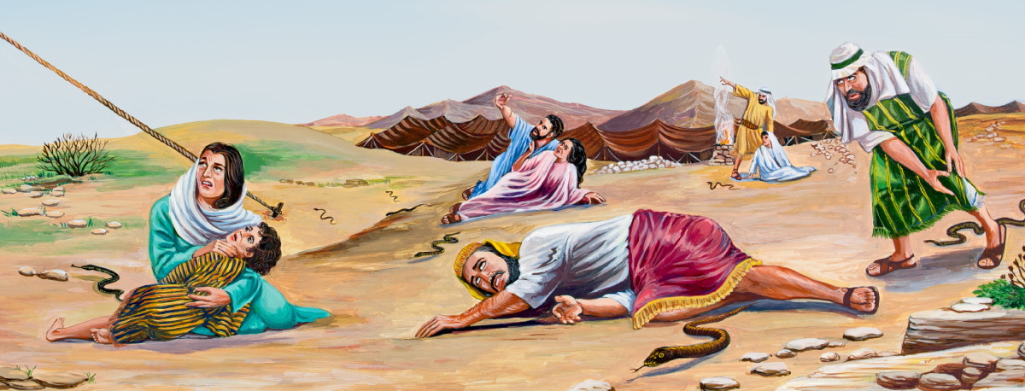
YHWH sent saraph serpents against the people. They bit the people and many of the Israelites died. The people came to Moses and said, “We sinned by speaking against YHWH and against you. Intercede with YHWH to take away the serpents from us!” And Moses interceded for the people– Numbers 21:6-7

Slide 15
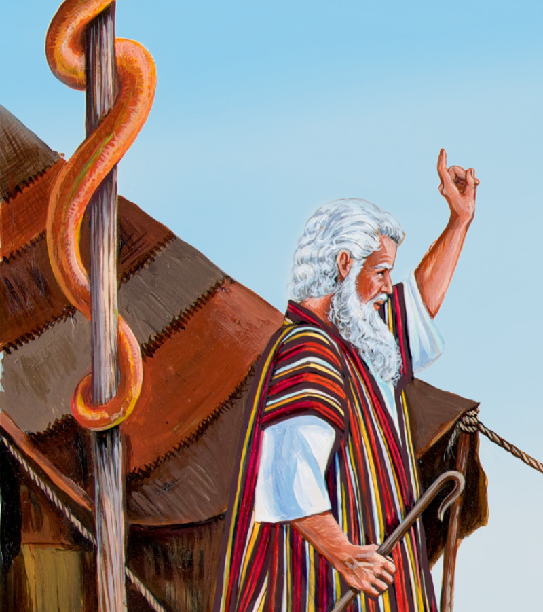
Then YHWH said to Moses, “Make a saraph figure and mount it on a standard. And if anyone who is bitten looks at it, he shall recover.” Moses made a copper serpent and mounted it on a standard; and when anyone was bitten by a serpent, he would look at the copper serpent and recover.
– Numbers 21:8-9

Slide 18
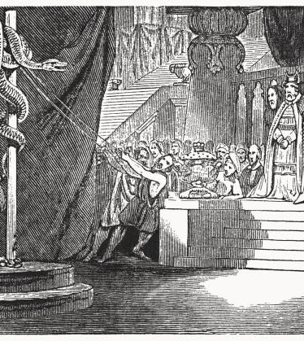
He removed the high places and broke the pillars and cut down the Asherah. And he broke in pieces the bronze serpent that Moses had made, for until those days the people of Israel had made offerings to it (it was called Nehushtan).
– 2 Kings 18:4

Slide 19
So an idol is anything that absorbs our affections more than God, even if it is something in the church. We may not have statues in our churches, but is it possible there are still some idols lying around in our church? If God’s true people had idols in Hezekiah’s day, and again in Christ’s day, chances are good we need to take a good look around, and see if there are any symbols, traditions or dates – as good and noble as they may be – that are absorbing more of our focus and worship than God.

Slide 21
Education
Beauty
A
D
Recognition/Showcase of Academic Achievement at God’s Place of Worship
Erotic and Sensual Showcasing treating God’s place as a catwalk
God’s
Gifts
Fame
Technology
B
E
Demagoguery and Popularity Politics in the House of God
Divided attention between God’s adoration and gadget’s/content creation
Money
Doctrine
C
F
Competition of Oppulence and Wealth in God’s Mission
Placing God’s Mission in a box of culture, tradition and doctrine – not His will, intent and purpose

Slide 22
Christ reiterated the truth that the sacrifices were in themselves of no value. They were a means, and not an end. Their object was to direct men to the Saviour, and thus to bring them into harmony with God. It is the service of love that God values. When this is lacking, the mere round of ceremony is an offense to Him. So with the Sabbath. It was designed to bring men into communion with God; but when the mind was absorbed with wearisome rites, the object of the Sabbath was thwarted. Its mere outward observance was a mockery.
–Ellen White, Desire of Ages Page 286

Slide 24
A Name for Ourselves
Then they said to one another, “Come, let us make bricks and bake them thoroughly.” They had brick for stone, and they had asphalt for mortar. And they said, “Come, let us build ourselves a city, and a tower whose top is in the heavens; let us make a name for ourselves, lest we be scattered abroad over the face of the whole earth.” - Genesis 11:3-4

Slide 25
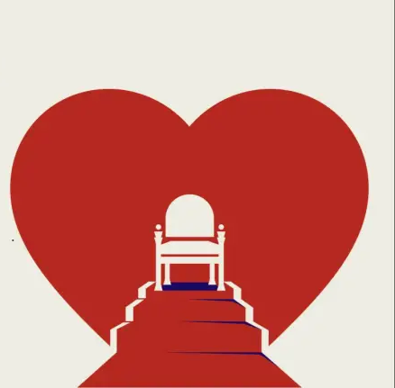
Then certain of the elders of Israel came to me and sat before me. And the word of the LORD came to me: “Son of man, these men have taken their idols into their hearts, and set the stumbling block of their iniquity before their faces. Should I indeed let myself be consulted by them? Therefore speak to them and say to them, Thus says the Lord GOD: Any one of the house of Israel who takes his idols into his heart and sets the stumbling block of his iniquity before his face, and yet comes to the prophet, I the LORD will answer him as he comes with the multitude of his idols, that I may lay hold of the hearts of the house of Israel, who are all estranged from me through their idols.
- Ezekiel 14:1-5

Slide 27
03
ERADICATION
01
EXAMINATION
Disconnect and Destroy cultures and habits that block our focus from God. Stop and End
In order for Josiah to get rid of the idols, he had to seek them out first. -
(2 Chronicles 34:3)
II Kings 23
Deuteronomy 12:3
2 Chronicles 15:8-12
…he began to seek the God of David his father, and in the twelfth year he began to purge off the high places of idols
Josiah from the study of the book of the Law; was able to call out the Idols and Corruption in the temple leadership and Elders. Bring the entire Israel into recognition of their rebellion to God
Tear down their altars, smash their pillars, put their sacred posts to the fire, and cut down the images of their gods,
obliterating their name from that site.
Under King Asa all Judah and Benjamin entered into a covenant to seek the Lord, the God of their ancestors, with all their heart and soul.
do a thorough job, which require recognizing which things are idols or were related to idol worship and had to be destroyed.
After we have examined ourselves, recognized the idols in our lives, and totally eradicated them, then we must re-dedicate our hearts to the Lord
02
04
RECOGNITION
RE-DEDICATION

Slide 28
and I will cut off your carved images and your pillars from among you, and you shall bow down no more to the work of your hands – Micah 5:13

Slide 29
If then you have been raised with Christ, seek the things that are above, where Christ is, seated at the right hand of God. Set your minds on things that are above, not on things that are on earth. For you have died, and your life is hidden with Christ in God. When Christ who is your life appears, then you also will appear with him in glory. Put to death therefore what is earthly in you: sexual immorality, impurity, passion, evil desire, and covetousness, which is idolatry.
- Colossians 3:1-5

Slide 30
